Slide 1
2023 Point-in-Time (PIT) Count of Persons Experiencing Homelessness: Unsheltered PIT Volunteer Training
Eastern and Western PA Continuums of Care
by Diana T. Myers & Associates, Inc. (DMA)
on behalf of the PA Department of Community and Economic Development (DCED)

Slide 2
What is the PIT count?
“Point-in-Time” (PIT) = a snapshot of the number of people experiencing homelessness on a given night
Required by HUD nationally during last 10 days of January
Includes people sleeping in:
sheltered locations. This can include emergency shelters, domestic violence shelters, sometimes motels, transitional housing
unsheltered locations. You will count people experiencing homelessness in unsheltered locations

Slide 3
What is the unsheltered count?
What does unsheltered mean?
Individuals or families whose primary nighttime residence is a public place not meant for human habitation
What does count mean?
Obtaining basic demographic information on each person and household

Slide 4
Why do we do a PIT count?
To measure and monitor trends and changes in homelessness on local and national levels
To help our community understand what resources we need and strategize the best ways to use them to end homelessness
To comply with federal regulations and requirements

Slide 5
When is the PIT count conducted?
2023 Unsheltered PIT Count Date: Wednesday, January 25, 2023
This refers to where someone slept during overnight hours on Wednesday evening Jan. 25th through Thursday morning Jan. 26th.
NOTE: The date cannot be changed by one county or RHAB. The entire CoC must conduct the count on the same date.

Slide 6
Unsheltered Count: Guiding Principles
Safety
Anonymity
Each person counted
Each person counted once

Slide 7
Unsheltered Count - Locations
Where will we find families and individuals who are experiencing homelessness?
You will be assigned to a particular area of the county where you will seek people staying in the following types of places:
Streets
Vehicles
Parks
Hunting cabins
Tents
Campgrounds
Barns
Truck Stops
Abandoned buildings
Transportation depots
Chicken coops
Railroad cars
Storage units
Lumberyards
Notes:
Unsheltered = Households in a public or private place not designed for or ordinarily used as a regular sleeping accommodation for human beings
Some of these may be acceptable sleeping accommodations in warm weather months, but not in February.
If unsure, document as much as you can so DMA or HUD can determine (e.g, if utilities are hooked up, which ones? attached or detached structure?) unfit does not necessarily mean inhabitable

Slide 8
Unsheltered Count - Locations
Where will we find families and individuals who are experiencing homelessness?
Some counties utilize a service-based count, where volunteers go to locations such as soup kitchens, community centers, etc. to identify and survey persons experiencing homelessness. Some counties do a street count and canvas the entire county, or hot spots within the count.
Your count coordinator will inform you of the local strategy for conducting the PIT count.

Slide 9
Unsheltered Count: Locations
Unsheltered Count DOES NOT include individuals living in these locations:
Hotels/motels not funded through public/ charitable resources
Shelters, transitional, or permanent homeless programs
Jails/prison
Emergency rooms/ hospitals
Halfway houses
Recovery houses
Residential/medical facilities
Youth in custody of state in foster care or other out-of-home placement
Doubled up in the homes of family/friends
Notes:
The PIT count does not include people who are precariously housed or at imminent risk of homelessness (in rental arrears, paying very large % of income for rent, in eviction process, or moving from relative/friend to relative/friend).
When in doubt, complete the form and provide as much detail as possible. Your county coordinator can help determine if someone can be counted, and the CoC also reviews all forms at the end to determine who should be included per HUD requirements
If you identify someone who is unsheltered and then they are transported to a shelter for the night they are then counted as SHELTERED-- you should coordinate with that provider around who will complete the survey (i.e. you could complete and cross out and mark as sheltered, or they can complete). But important to make sure they are not counted twice.

Slide 10
Unsheltered Count – Who?
All household types are included:
Households with children
Households without children
Couples- married and unmarried
Single individuals
Other makeups where the persons define themselves as a household (intergenerational households of adults, siblings, etc.) and there are no children
Youth
unaccompanied children < age 18
unaccompanied youth, 18-24
parenting youth

Slide 11
Unsheltered Count – How?
Unsheltered PIT surveys are conducted either via:
Brief Interviews
Observation Only

Slide 12
Unsheltered Count – How?
Brief interviews – preferred
Complete one Interview Form for each household
If a household has more than five members please record additional data on a second form, clearly indicating that they are part of same household
If a household includes more than one person, please ensure that data is recorded on the form consistently recording the data based on the assigned “person #”.
e.g. If LH is person # 1 and BH is person # 2 on page 2, please ensure that BH is also person # 2 on the subsequent pages.

Slide 13
Unsheltered Count – How?
Observation - If someone will not or cannot provide the information requested on the Interview Form, complete the observation only section at end of survey based on your observation.
It is very important that you fill out the entire section.
This section is where we tend to see the most errors or issues. More info on this in a few slides.

Slide 14
Completing the survey form

Slide 15
Survey Forms: Before beginning
Write your county name at the top left.
Please write your name or team name/number on the top right of the form, along with the date/time of count. This is very important in case we have questions about your survey.

Slide 16
Survey Forms: Introduction
Hello, I am (introduce yourself by your first name). We are conducting a survey to count people experiencing homelessness in order to learn more about people experiencing homelessness, what kinds of problems they face, and to better understand what services are needed to address homelessness. Your participation is voluntary and your response to each question is voluntary. I will ask for your initials and your age, but I will not need your name, date of birth, social security number, or any other information that could be traced back to you. The responses to these questions will not be shared with anyone outside of our team. I will need to read each question all the way through.
Note: This script is also on the interview forms.

Slide 17
Survey Forms: Consent & Screening
Can I have 10 minutes of your time?
If no, and you believe this individual/ household is sleeping in an unsheltered location, please discontinue the survey and instead complete the observation information at end of survey.
If individual is asleep, please proceed to observation section.
Did another volunteer or survey worker already ask you questions about where you are sleeping the night of Jan. 25th (insert: tonight or last night)?
If yes, please discontinue the survey. No further information is needed.

Slide 18
Brief surveys
Notes:
If you are able to interview the person, you will complete the questions within the PIT brief survey

Slide 19
Brief Surveys: What information are we collecting?
Number of persons in household
For each person in household:
Age (or age range)
Ethnicity
Gender
Race
Additional data collected for adults or youth under 18 who are head of household:
Number of homeless episodes and length of time homeless
Domestic violence status (not asked in front of two adults who have identified that they are part of the same household)
Veteran status
Disability information

Slide 20
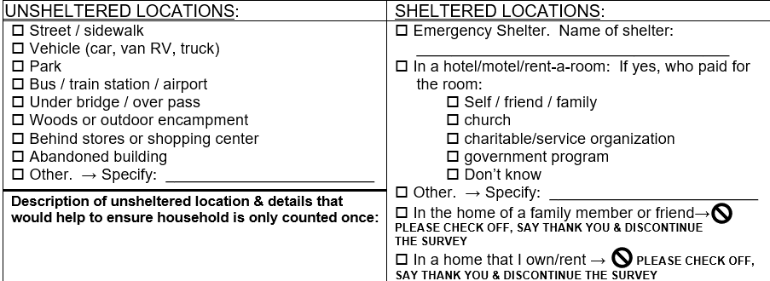
Brief Survey: Where did you sleep?
Where are you sleeping/did you sleep the night of Jan. 25^{th?}
Households in the locations above will be included in the unsheltered PIT count.

Slide 21
Brief Survey: Where did you sleep?
In addition to checking off the appropriate unsheltered location, please write down any details about location.
This is very important. This information is used to ensure a household is not double counted. If you do not have time to fill this out in the moment, please make sure you complete it before turning in your surveys.
Please provide as much identifying information as possible.
e.g. Blue tent behind Walmart in Pennsylvaniatown; sleeping in brown van in Flying J Truck Stop in Centralville

Slide 22
Brief Survey: Where did you sleep?
Emergency Shelter. Households in emergency shelters will be counted in the sheltered PIT count. If you transport a household to shelter, please coordinate how the information on this Interview Form will be collected, on the Unsheltered Interview Form or by the Shelter.
In a hotel/motel/rent-a-room: If yes, who paid for the room? If a household is sleeping in a hotel room on 1/25/23 that is paid for by government/non-profit, they should be included in the sheltered PIT count. Programs that provide hotel vouchers are included in the sheltered PIT count. If you encounter someone sleeping in a hotel on the PIT night and they have not yet completed an interview form, please complete the interview. If you provide transportation to a hotel and/or hotel vouchers during your unsheltered PIT count, please complete this Interview Form.
Other. → Specify: Depending on the location, this household may or may not count in the unsheltered or sheltered PIT count.
In the home of a family member or friend→ PLEASE CHECK OFF, SAY THANK YOU & DISCONTINUE THE SURVEY
In a home that I own/rent → PLEASE CHECK OFF, SAY THANK YOU & DISCONTINUE THE SURVEY

Slide 23
Brief Survey Questions
If you identify that the household is unsheltered, please complete the remaining questions.
Inform participants participation is voluntary. Individuals may refuse to answer some or all questions.
Information is self-report: please do not assume any information.

Slide 24
Brief Survey Questions
Initials only, no name. If person refuses to give initials, assign initials and complete rest of interview.
Age – If a person does not wish to share, please estimate age range.
Gender, ethnicity, and race – Read the lists out loud and have the person self-identify their response. Please do not assume a response.

Slide 25
Brief Survey Questions
Ask all questions as written on the Interview Form or within the Mobile App.
Demographic questions should be asked of all household members.
Domestic violence and additional questions should be asked only of adults or youth under 18 who are head of household (these instructions are on the form).
Domestic violence questions should not be asked if two adults are being interviewed together (these instructions are on the form).

Slide 26
Observation only

Slide 27
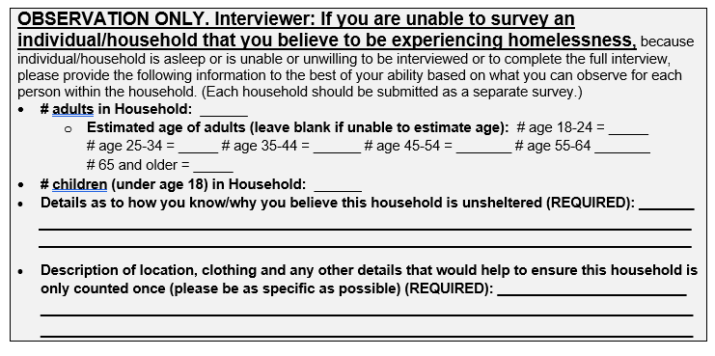
Unsheltered Count – Observation Only
Observation Only Section
MUST fill out details and description sections. Without enough information sometimes we have to exclude the survey and not count the individual.
Notes:
It is preferred that everyone be interviewed if at all possible, as this provides the highest quality information and most complete information.
However, if an interview is not possible because the person is sleeping, or refuses to be interviewed, or if there is a concern about safety or safely accessing the specific location, then please fill out the observation information.

Slide 28
Unsheltered Count: Observation Only
When to conduct count by observation only
Individual/household is asleep/bedded down (you must indicate this on the form)
Individual/household is unwilling to be interviewed/ complete the full interview, but you believe them to be experiencing homelessness (you must indicate the details on the form).
E.g., on a park bench outside in winter with all of their belongings
E.g., the individual is known to you and your team
28

Slide 29
Unsheltered Count: Observation Only
What is the person wearing? (e.g., “black beanie, navy sweatshirt, jeans, and tan utility boots.” or “bundled in a grey, puffy sleeping bag that covered their face.”)
What does the person look like? (e.g., “shoulder-length grey hair, white, female, 50-60 years old”)
Why were you unable to complete a survey with them? (e.g., “They said they did not want to complete a survey, but they were awake.”)
Where did you see them? (e.g., “In front of the TD bank at the corner of 6th and Cedar St.”
What makes you think that they are or may be experiencing homelessness? (e.g., “They were sleeping on a park bench with a large bag of their belongings next to them.”)
Write down as much detail as possible that helps to make the person identifiable and to provide clues on their housing status.

Slide 30
Unsheltered Count: Observation Only
“I saw a man in a red sweatshirt riding by on a bike by that looked homeless.”
Not enough detail (age, appearance, location, details of why you believe they are experiencing homelessness)
If we have more information, the unsheltered coordinator can work to make sure they were not counted by another team or an emergency shelter
When is an observational survey NOT appropriate?
Why not appropriate?
Dunkin Donuts said there is a man who hangs out sometimes who is homeless.
Third party reports are not appropriate to include in the PIT count. The person must be counted/observed by your team.

Slide 31
Unsheltered Count: Observation Only
We need your help to ensure that the observation only section is filled out properly. If we do not have details about the sleeping location and details to help ensure the household is only counted once, we often must exclude the survey.
31

Slide 32
After the Interview
Your Role
Record what you heard and observed
Walk away from the person interviewed to a safe place
Take a few minutes after your conversation to double check that you’ve completed the whole survey form
Include any additional notes or details
Make sure everything you have written is readable
Please turn all forms in to your county unsheltered PIT coordinator at the conclusion of the count. If your county is using the PIT mobile app, surveys will be submitted automatically as they are completed.

Slide 33
Walk through PIT survey form

Slide 34
Best Practices and Safety Considerations

Slide 35
Best Practices
Keep in mind:
Individuals sleeping outside may be dealing with active addiction, mental health concerns, and significant trauma histories. Do not sneak up on or startle people. Never shine flashlights in people’s faces.
Maintain eye contact (if possible) and an open stance with your hands visible. Use a tone of voice that’s approachable. Speak slowly, be polite, and don’t shout.

Slide 36
Best Practices
Remember that you are speaking to highly vulnerable people. Always lead with respect for the person you’re speaking with and respect for their dignity.
Everyone has the right to refuse to answer any or all of your questions.
Ask all questions, unless the person has already given the answer to the question over the course of your conversation.
Always ask questions as they are written; do not ask questions in a way that shows you think you already know the answer.

Slide 37
Best Practices
If this is your first PIT count or you would like more guidance on how to approach an individual who is unsheltered, we recommend this video from the Homeless Hub out of Canada:
How to approach an individual on the street training video:
https://www.homelessnesslearninghub.ca/library/resources/how-approach-individual-street-video

Slide 38
Considerations for Domestic Violence Survivors
If you identify someone who is fleeing DV or identifies as a domestic violence survivor during the PIT Count:
If the survivor is interested, refer to local DV program for safety planning assistance
PIT volunteers are not expected to safety plan, but if engaged, listen to the survivor and ask what they need
What has worked for you to stay safe in the past?
What do you need to stay safe tonight? Tomorrow?

Slide 39
Considerations for Domestic Violence Survivors
Make sure the survivor knows that all collected information from the PIT count is non-identifiable
Make sure the survivor knows that you will not share their disclosure and/or story with anyone, other than submitting non-identifiable data
If a survivor feels uncomfortable sharing, don’t press for information

Slide 40
Safety Considerations
The safety of all PIT count volunteers is of highest priority. Please do not enter a situation that is unsafe. This may include:
Building that is not structurally sound.
Traveling down unpaved/ snow covered roads unless you are in a car that can handle those conditions.
Approaching an individual or group of people if it does not feel safe.
Volunteers should always go out in teams (should never conduct interviews or observations alone).

Slide 41
Next Steps

Slide 42
Items to review with your county unsheltered PIT coordinator:
Schedule
Key Contacts
Safety Protocols
What to bring
Method for submitting surveys
Any other questions you have
Logistics

Slide 43
Additional Resources:
If you would like additional resources on the Point in Time Count:
How to approach an individual on the street training video:
https://www.homelessnesslearninghub.ca/library/resources/how-approach-individual-street-video
HUD sample handout with tips and resources for volunteers conducting the PIT Count:
https://files.hudexchange.info/resources/documents/PIT-Count-Volunteer-Training-Toolkit-Sample-Refresher-Handout.docx

Slide 44
Contact Information
Pease contact your county unsheltered PIT coordinator with questions. If you still need help you can email pahomelesscount@dma-housing.com
CoC PIT Count website:
https://pennsylvaniacoc.org/2023-point-time-pit-count
All PIT materials will be posted here

Slide 45
FINALLY...
THANK YOU for
Giving your time
Caring
Helping
Showing up!
THANK YOU FOR BEING PART OF THE 2023 UNSHELTERED PIT COUNT!

